Slide 1


Group-6

Slide 2

A
G
E
N
D
A
Vue + Vite
Vue + Option API
Vue + Composition API
Vue + Pania
Vue + Tailwind Css

Slide 3
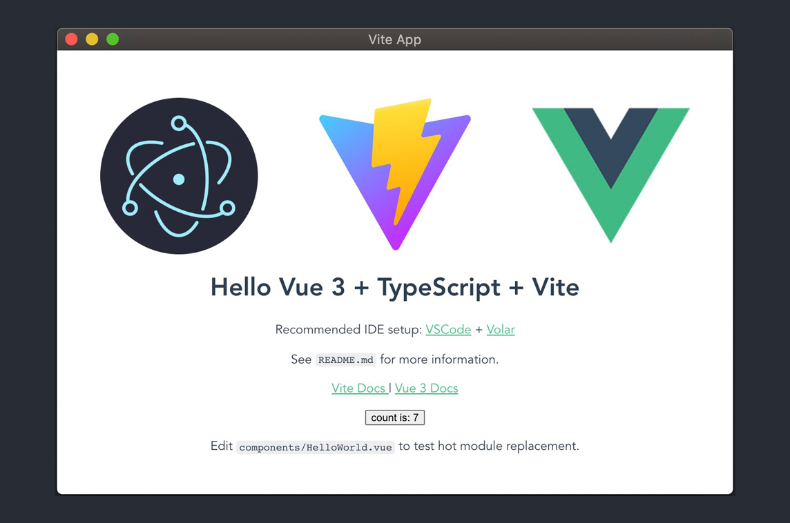
Vue + Vite
A
G
EN
D
A
What is Vite ?
Why use Vite ?
How to instore Vite ?

Slide 4

What is Vite ?
=> Vite is a french word meaning ‘Fast’, and pronounced ‘Vit’.
A
G
EN
D
A

Slide 5

Why use Vite ?
Vite is use one page.
Vite is faster than VueJS (run on server)
Interested than VueJS.
Not use axios (DEV show API).
Use one file.
A
G
EN
D
A

Slide 6
How to instore Vite ?
Getting start :
npx create-vite-app <project-name>
Change directory to project :
cd <project-name>
Install node modules :
npm install
Start the Vite Dev environment by running :
npm run dev
A
G
EN
D
A

Slide 7


Vue + Tailwindcss
What is vue tailwindcss?
What are the advantages of vue tailwindcss?
Ho to install Vue Tailwind

Slide 8


What is Vue tailwind CSS?
Tailwind CSS is basically a utility CSS framework for rapidly building custom user interfaces. It is a utility-first CSS framework which means we can use utility classes to build custom designs without writing as in the traditional approach and faster UI building process
https://tailwindcss.com/docs/installation
You can install Vue Tailwind by using common
https://tailwindcss.com/docs/installation

Slide 9

What are the advantages of vue tailwindcss?
Easy to use
Faster than use CSS
Easy to find which
element that we want to update

Slide 10
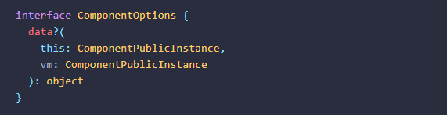
Vue Option API
Data
A function that returns the initial reactive state for the component instance

Slide 11

Vue Option API
template
A string template for the component.

Slide 12

Vue Option API
Lifecycle
#beforeCreate
Called when the instance is initialized.

Slide 13

Vue Option API
Composition
#provide
Provide values that can be injected by descendent components.

Slide 14

Vue Option API
Misc
# name
Explicitly declare a display name for the component..

Slide 15
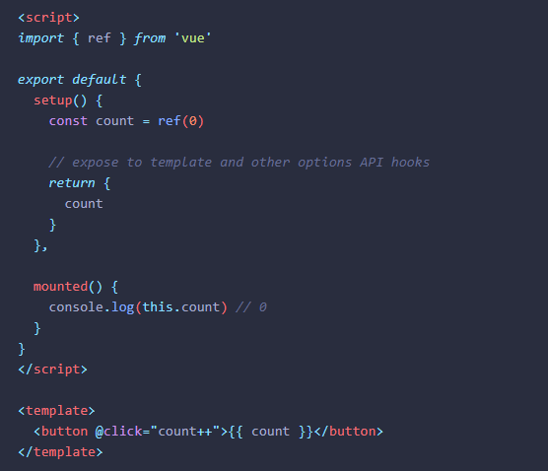
Vue Composition API
setup
# Composition API: setup()

Slide 16
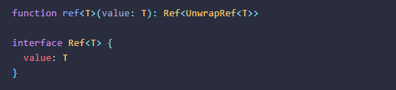
Vue Composition API
Core
# ref()
Takes an inner value and returns a reactive and mutable ref object, which has a single property .value that points to the inner value.

Slide 17
Vue Composition API
Utilities
# isRef()
Checks if a value is a ref object.
# unref()
Returns the inner value if the argument is a ref, otherwise return the argument itself. This is a sugar function for val = isRef(val) ? val.value : val

Slide 18
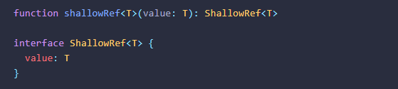
Vue Composition API
Reactivity API: Advanced
# shallowRef()
Shallow version of ref()

Slide 19
Vue Composition API
Dependency injection
# provide()
Provides a value that can be injected by descendent components.

Slide 20
Vue Composition API
Lifecycle Hooks
# onMounted()
Registers a callback to be called after the component has been mounted..

Slide 21

Vue + Pinia

Slide 22
What is Pinia?
Pinia started as an experiment to redesign what a Store for Vue could look like with the Composition API around November 2019. Since then, the initial principles are still the same, but Pinia works for both Vue 2 and Vue 3 and doesn't require you to use the composition API.

Slide 23
How to install Pinia?
To install Pinia (npm init vue@latest)
Run Pinia (npm run dev)

Slide 24
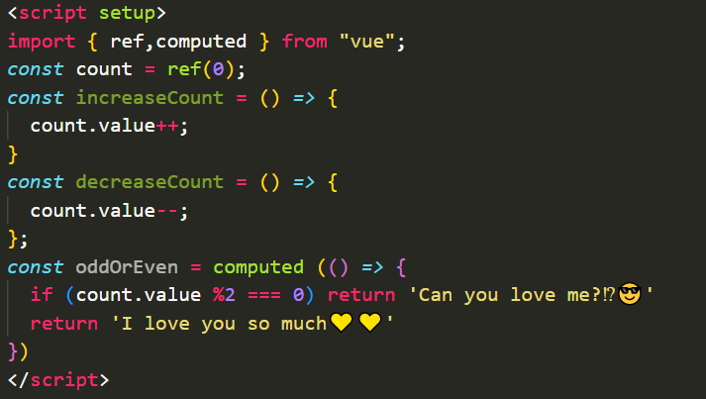
To store Data

Slide 25
Thank you!

